Slide 1
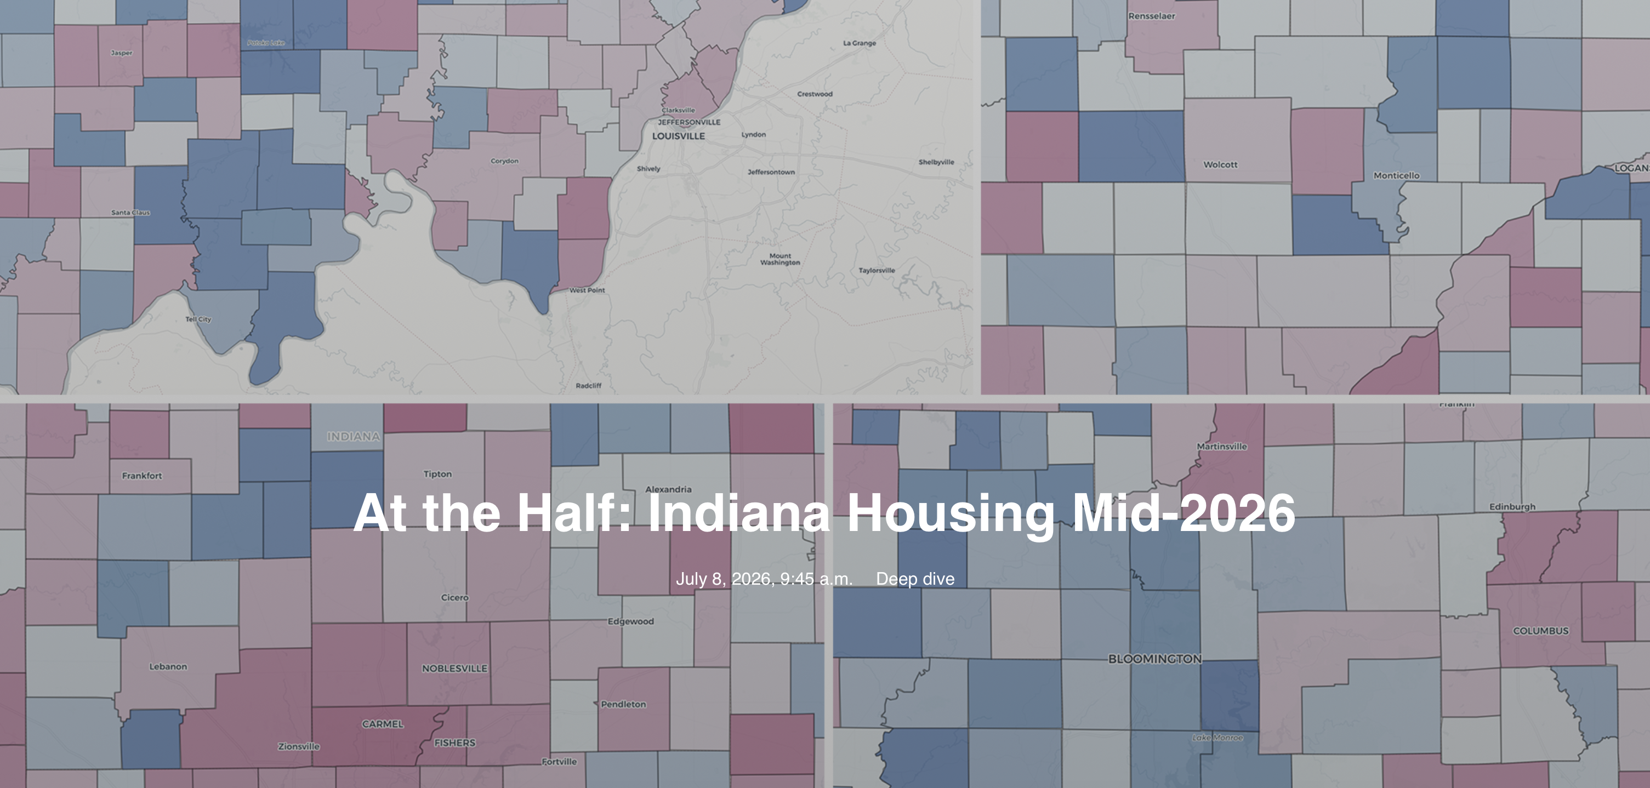

At the Half: Indiana Housing Mid-2026 — Indiana Association of REALTORS® 1

Slide 2
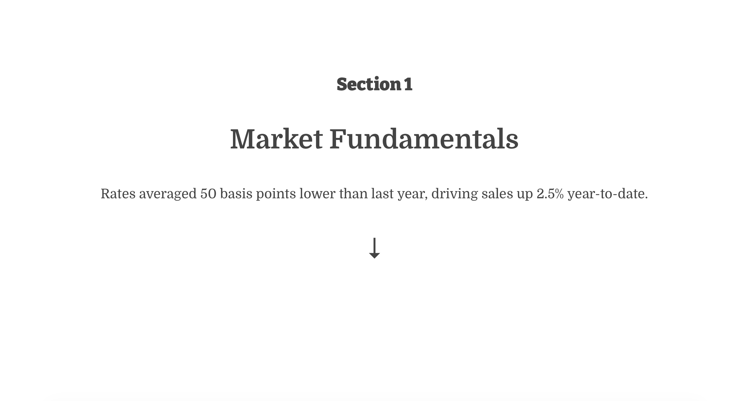
At the Half: Indiana Housing Mid-2026 — Indiana Association of REALTORS® 2

Slide 3
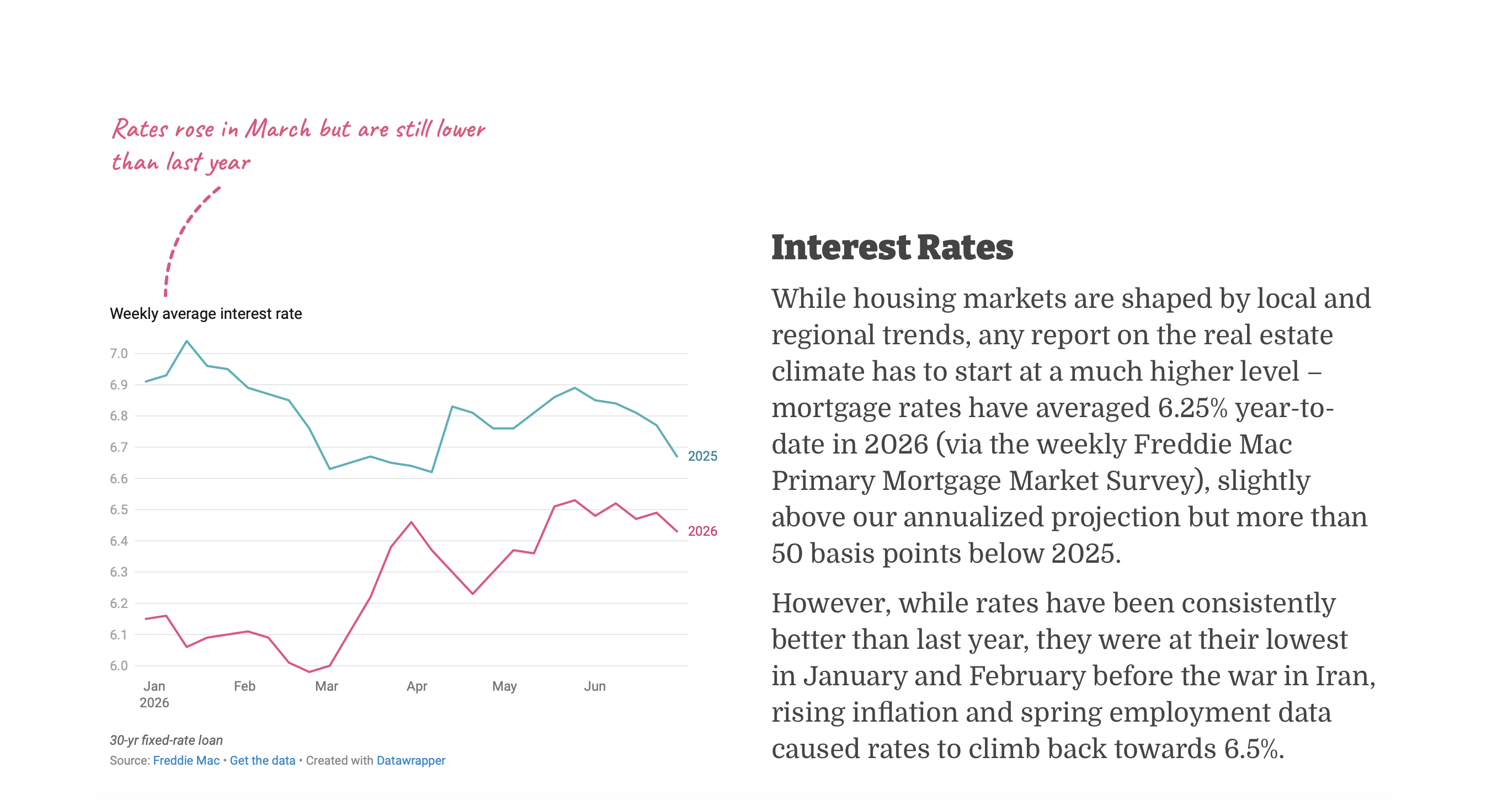
1. Market Fundamentals
At the Half: Indiana Housing Mid-2026 — Indiana Association of REALTORS® 3

Slide 4
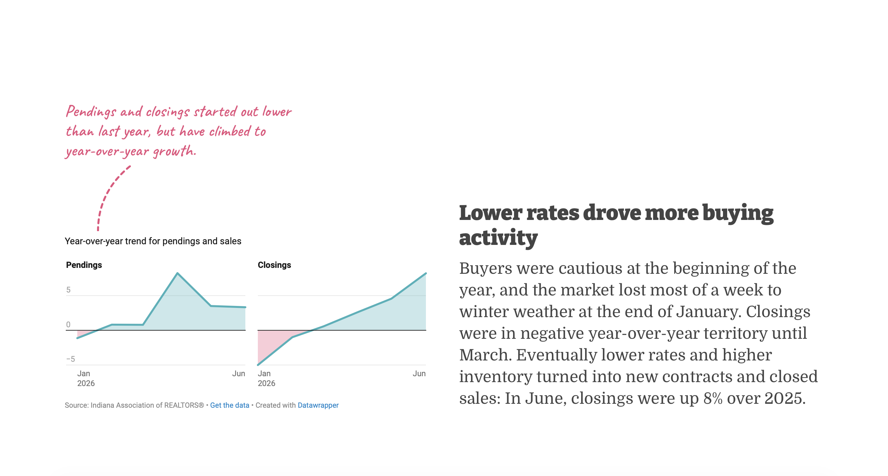
1. Market Fundamentals
At the Half: Indiana Housing Mid-2026 — Indiana Association of REALTORS® 4

Slide 5
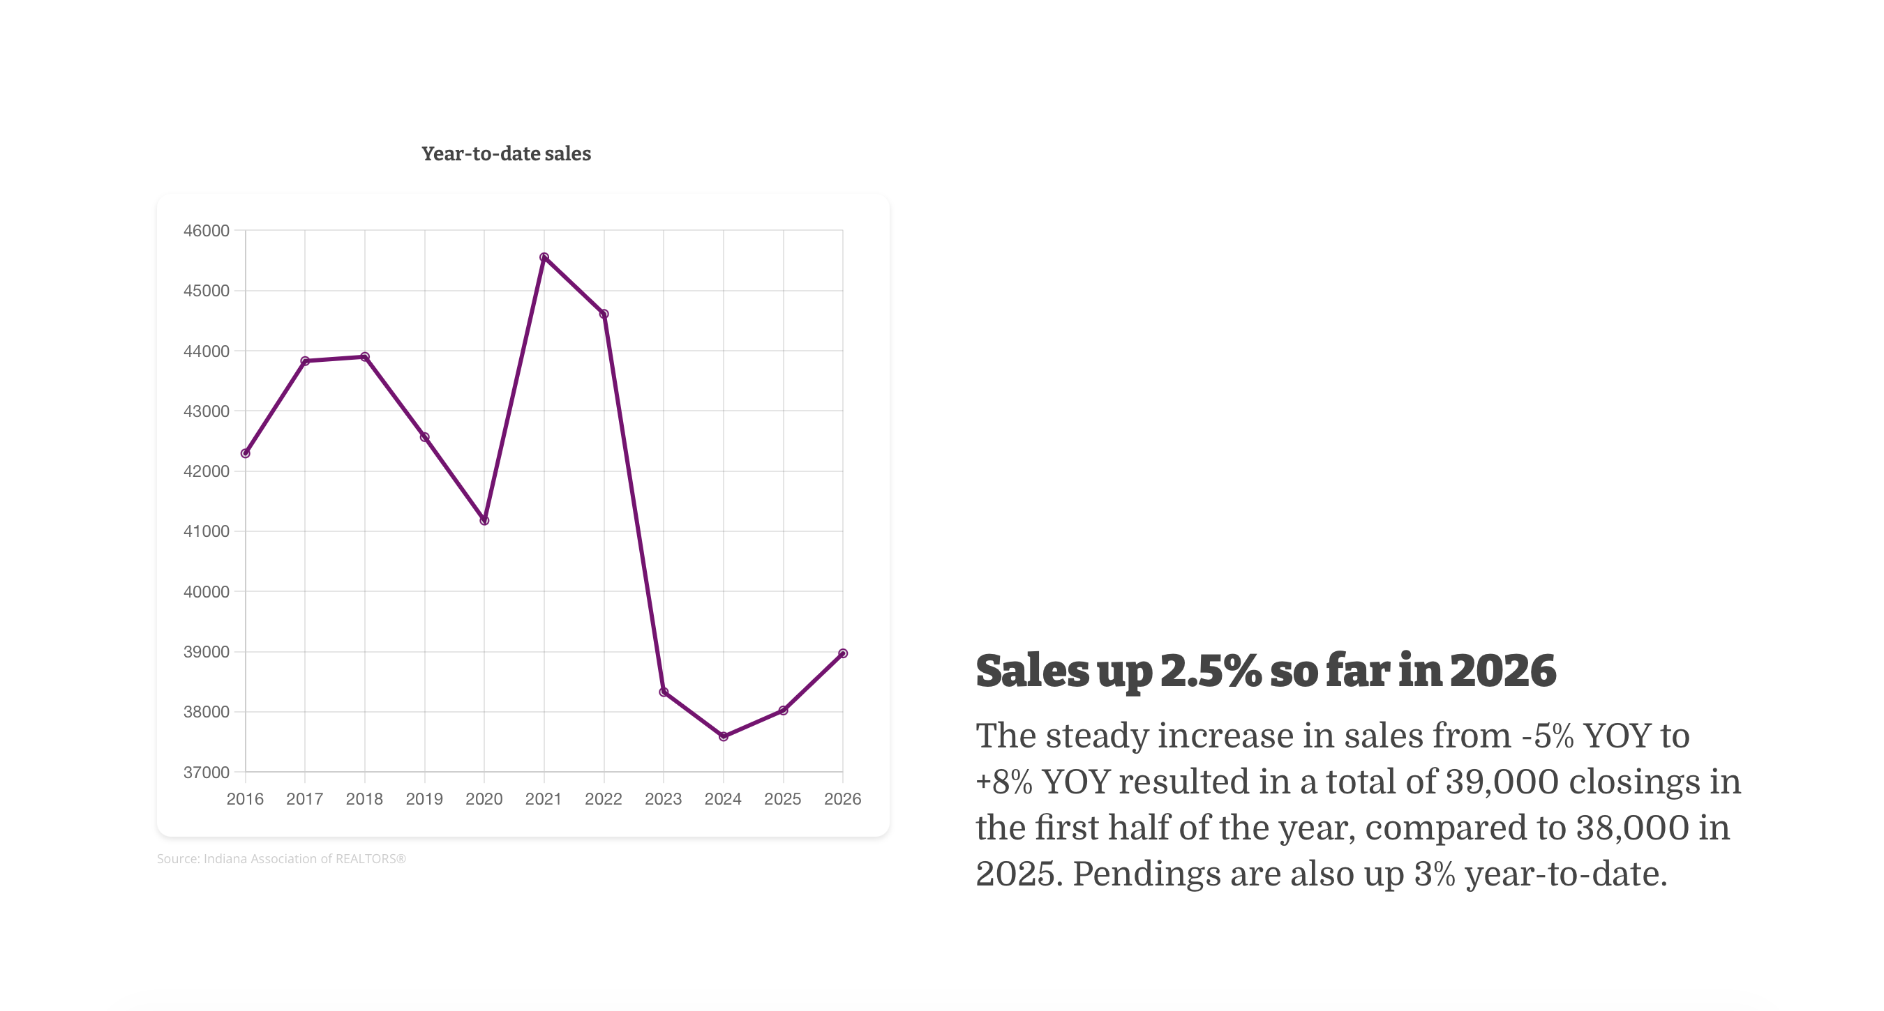
1. Market Fundamentals
At the Half: Indiana Housing Mid-2026 — Indiana Association of REALTORS® 5

Slide 6
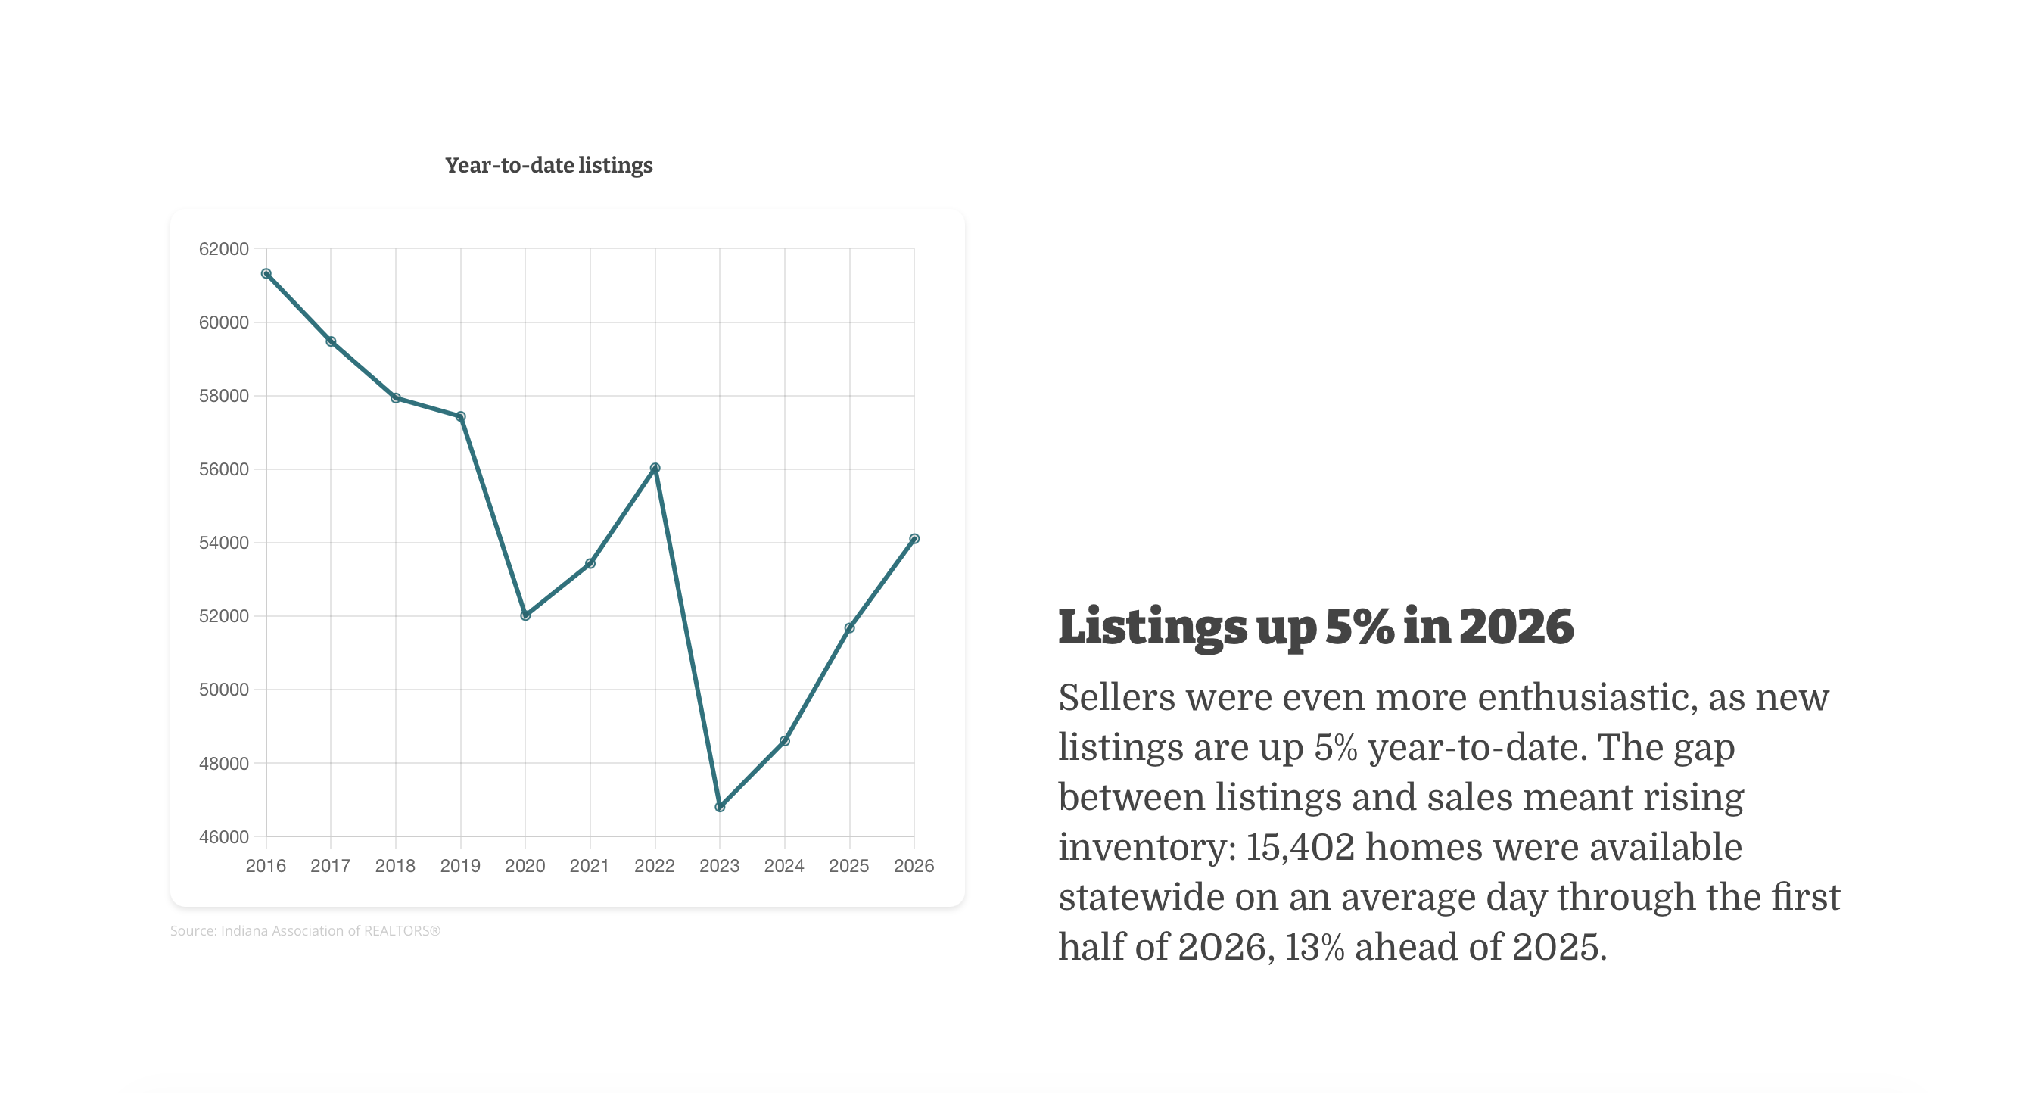
1. Market Fundamentals
At the Half: Indiana Housing Mid-2026 — Indiana Association of REALTORS® 6

Slide 7
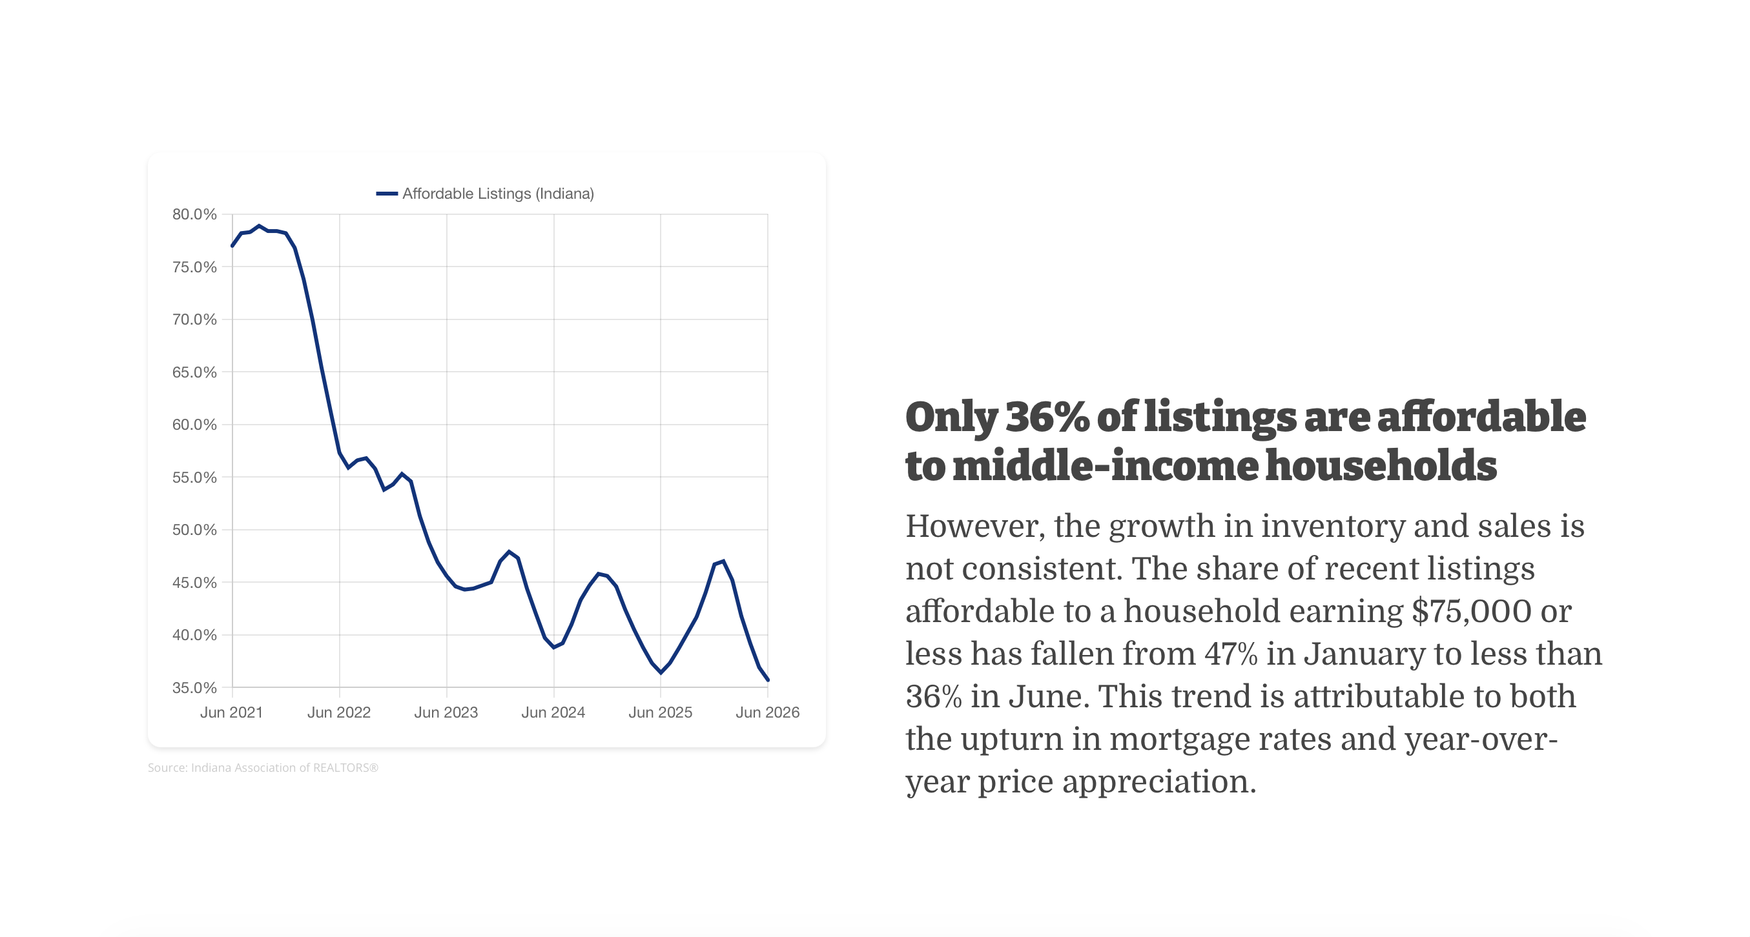
1. Market Fundamentals
At the Half: Indiana Housing Mid-2026 — Indiana Association of REALTORS® 7

Slide 8
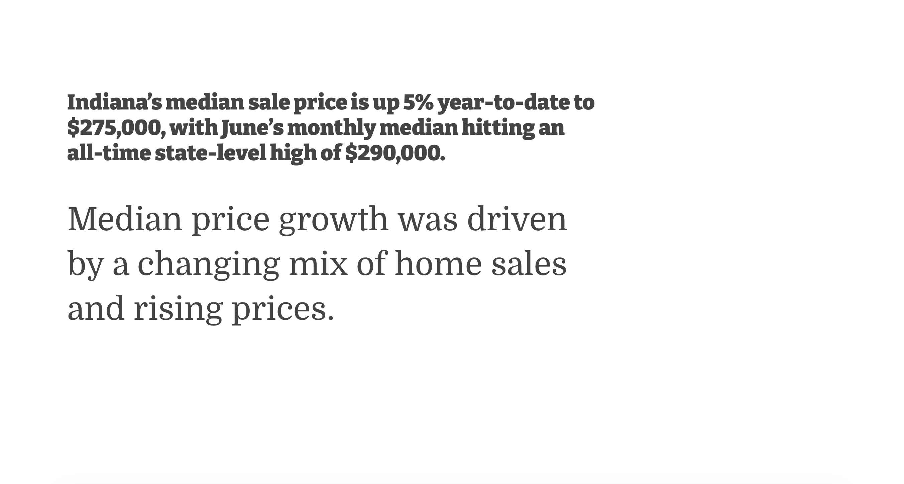
1. Market Fundamentals
At the Half: Indiana Housing Mid-2026 — Indiana Association of REALTORS® 8

Slide 9
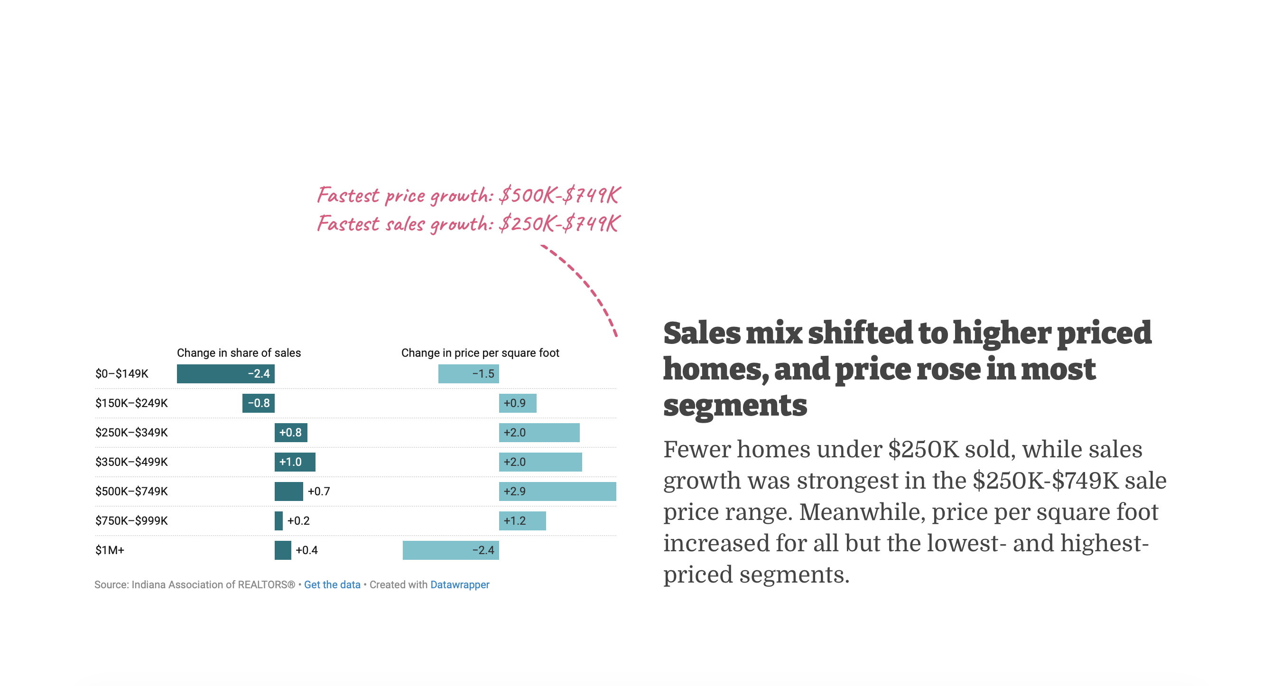
1. Market Fundamentals
At the Half: Indiana Housing Mid-2026 — Indiana Association of REALTORS® 9

Slide 10
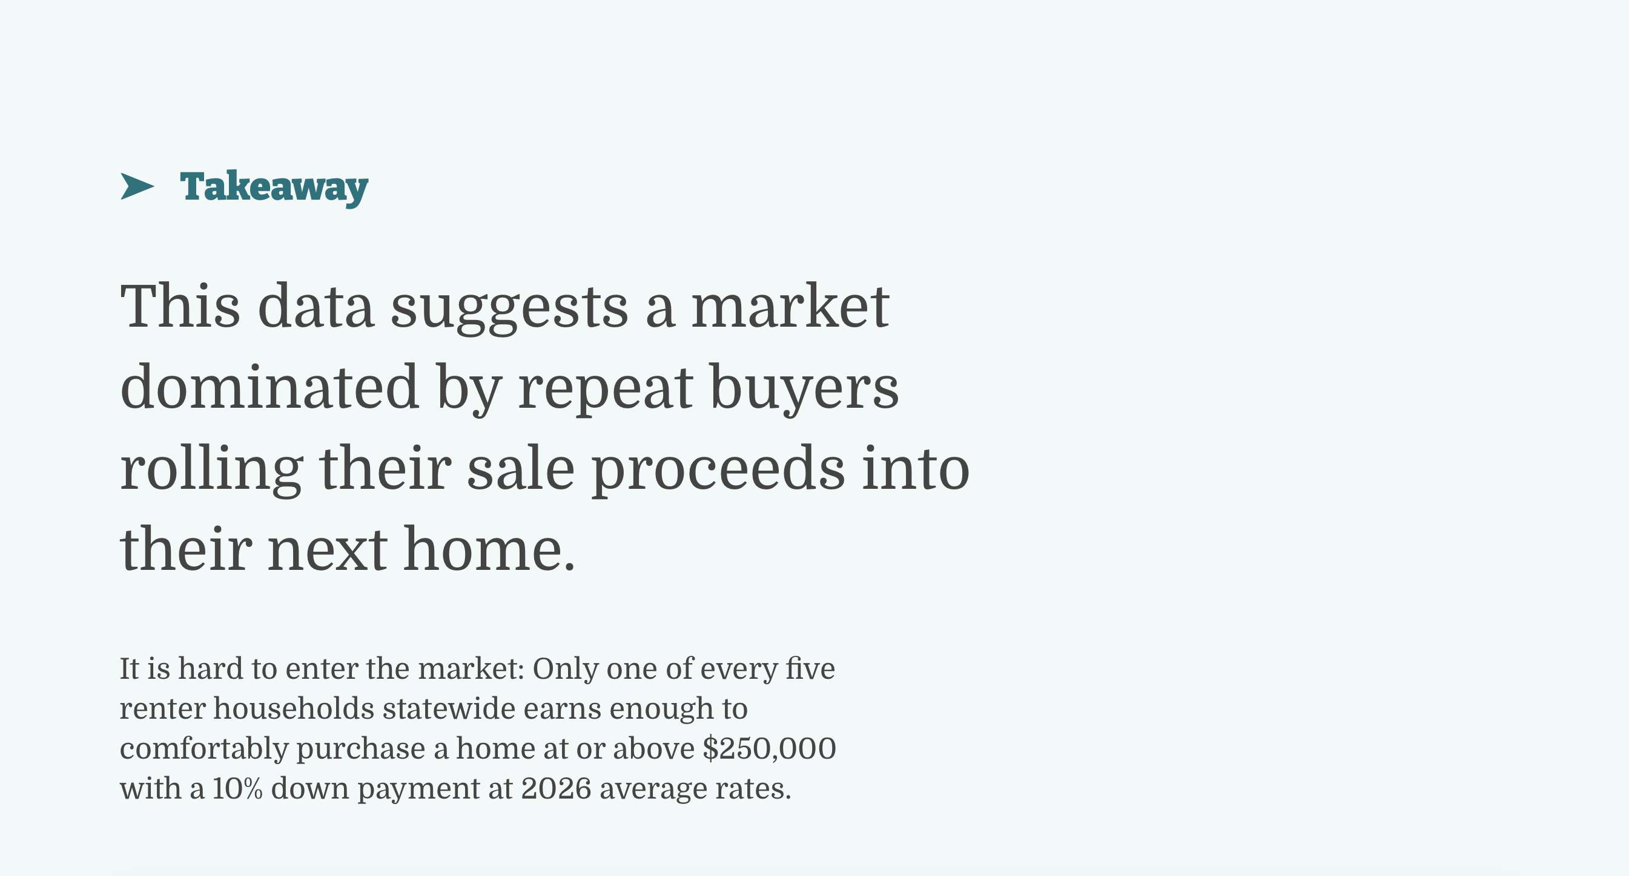
1. Market Fundamentals
At the Half: Indiana Housing Mid-2026 — Indiana Association of REALTORS® 10

Slide 11
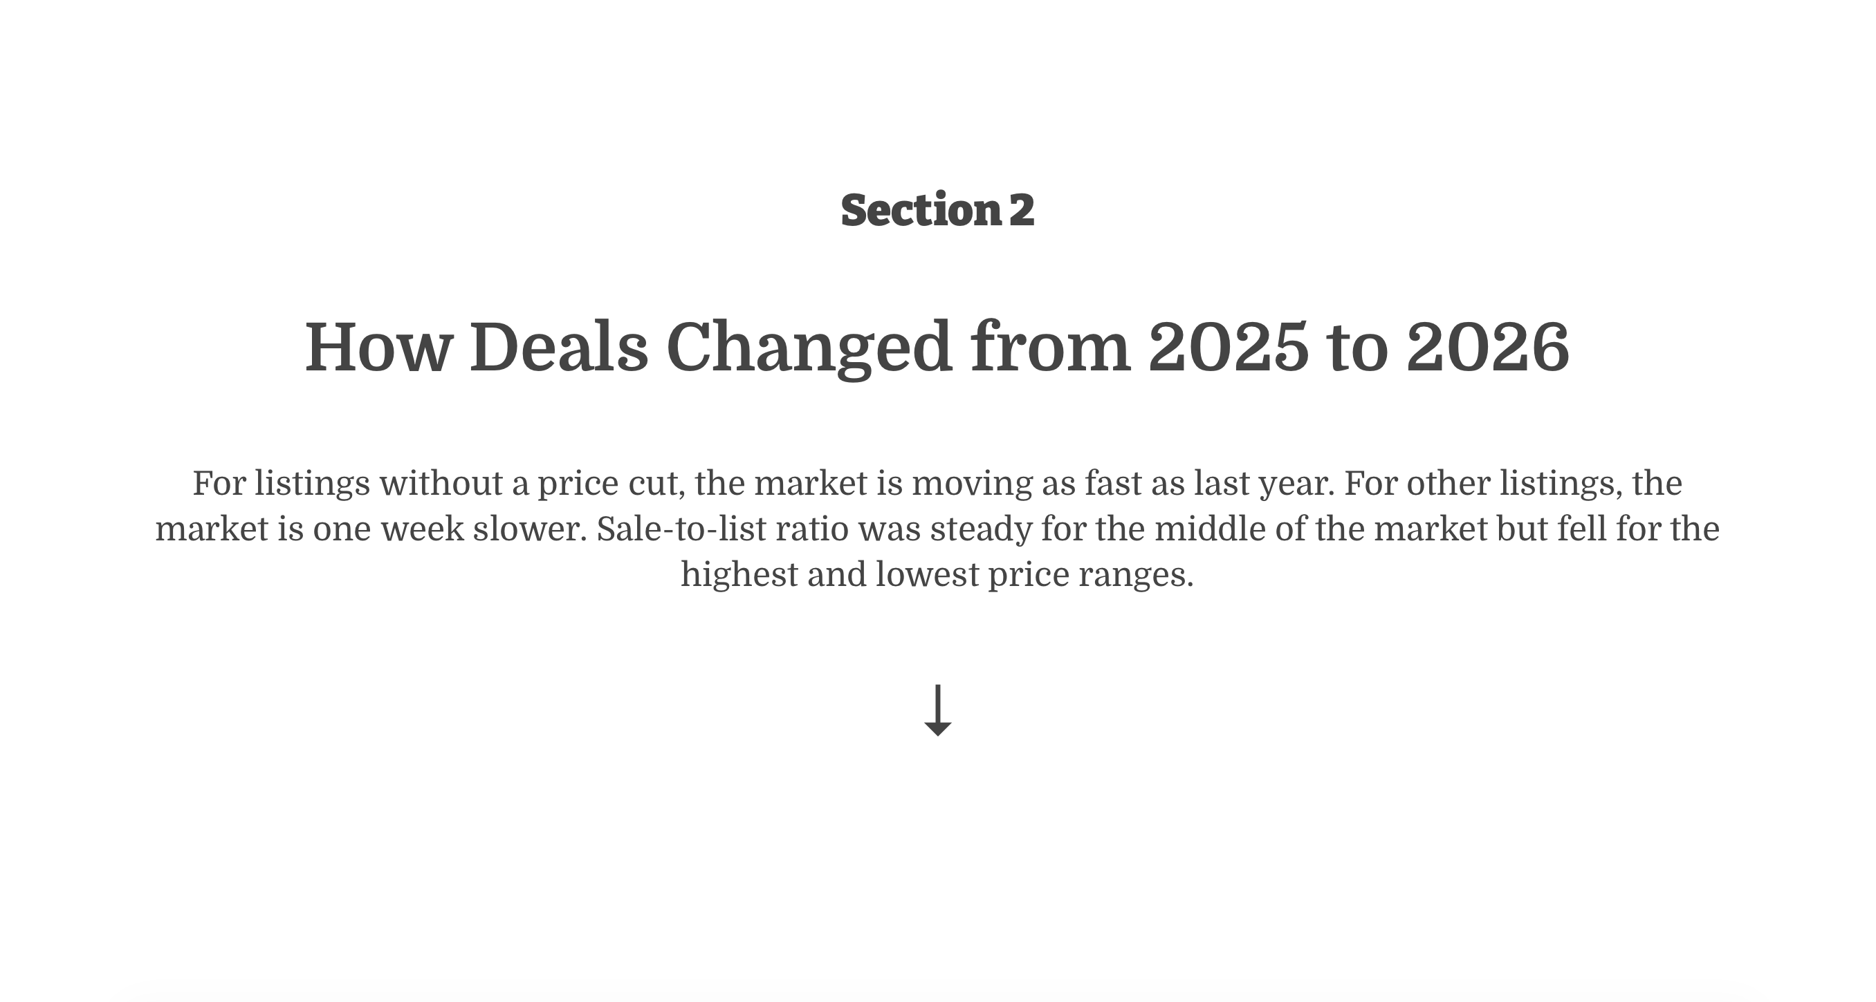
At the Half: Indiana Housing Mid-2026 — Indiana Association of REALTORS® 11

Slide 12
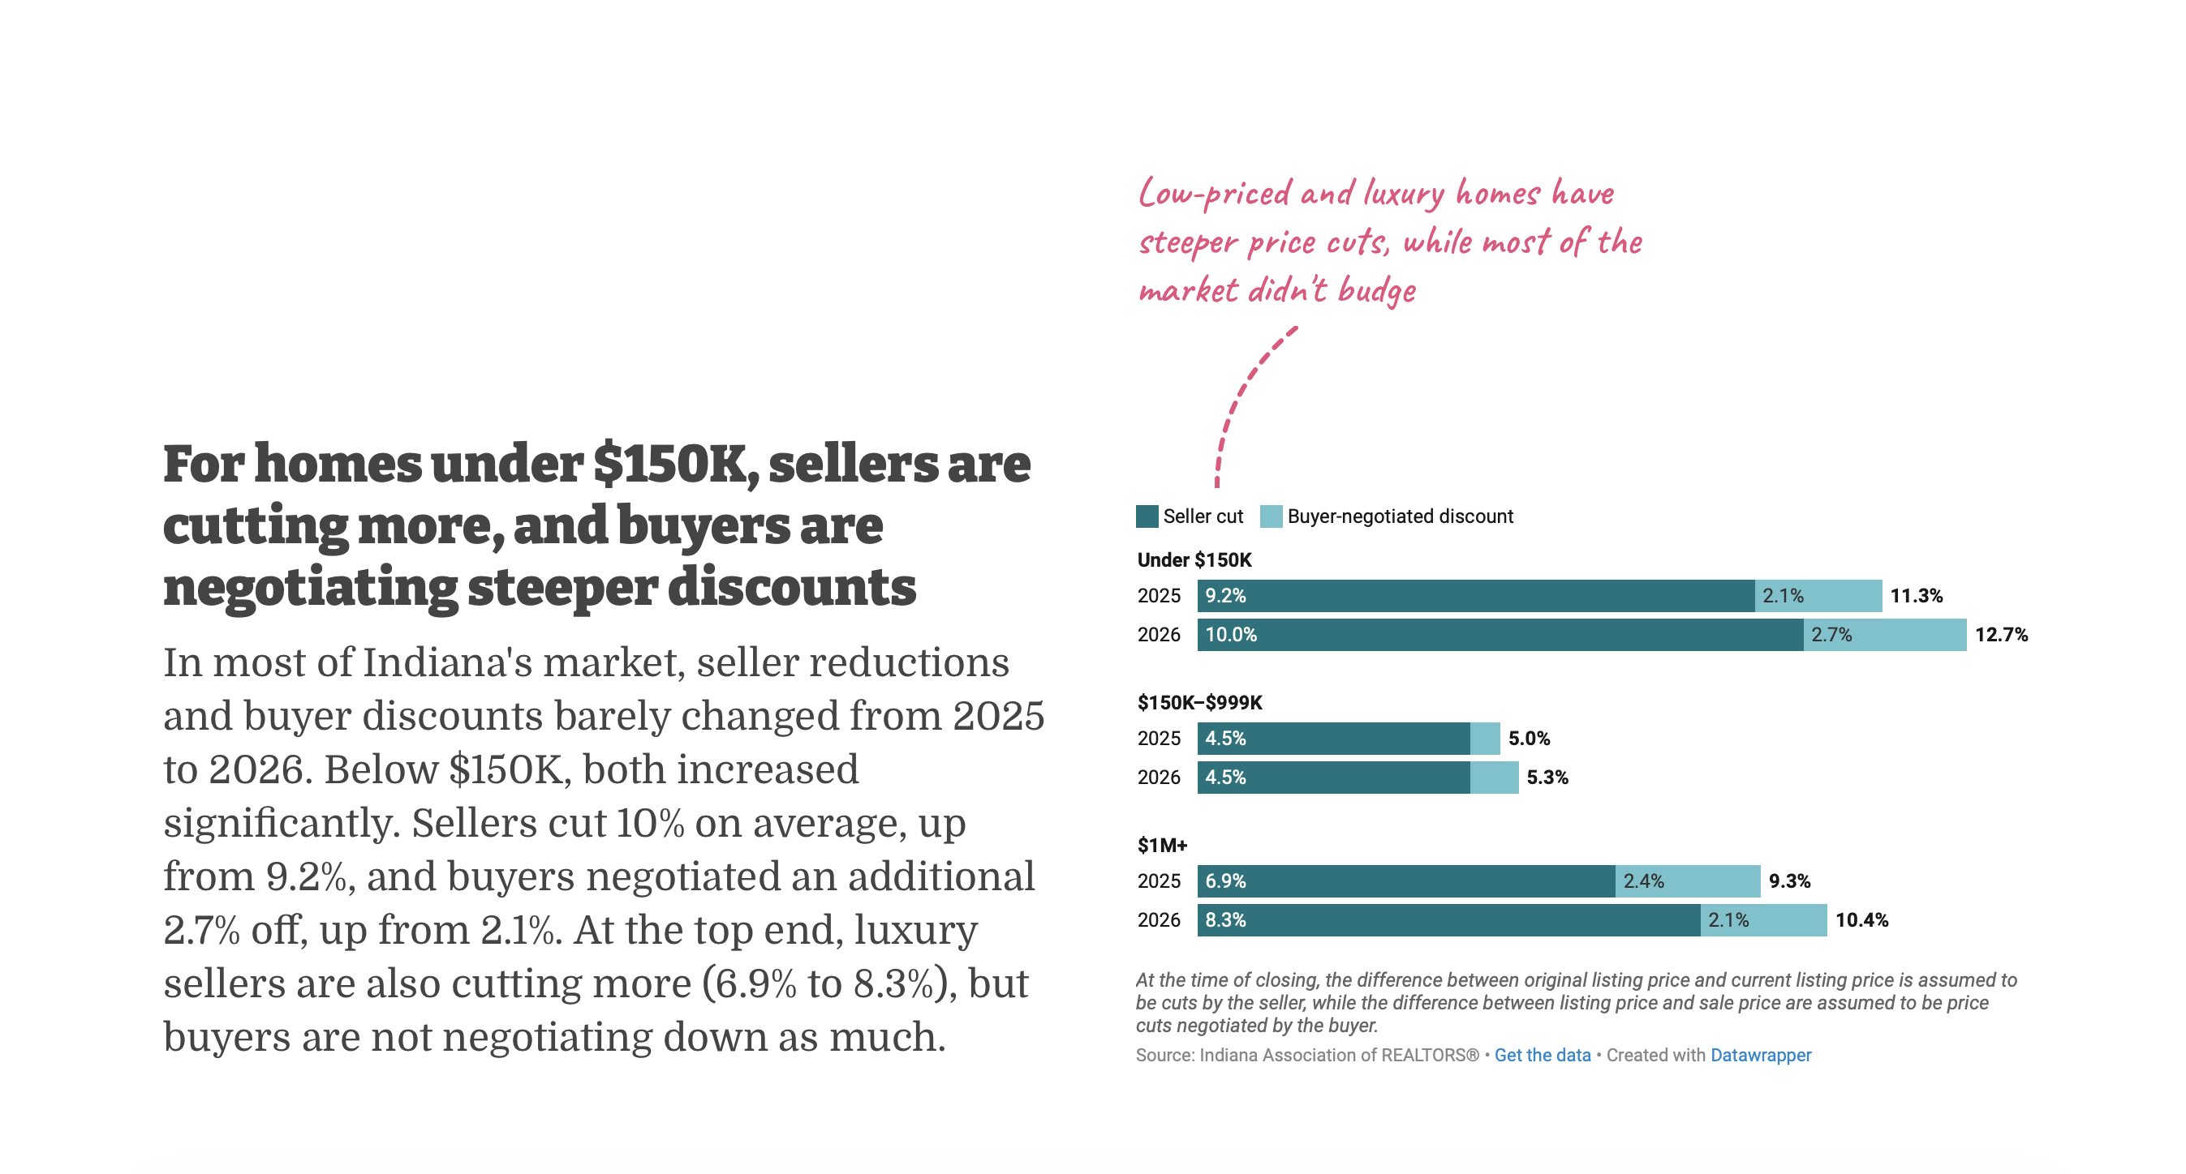
2. How Deals Changed
At the Half: Indiana Housing Mid-2026 — Indiana Association of REALTORS® 12

Slide 13
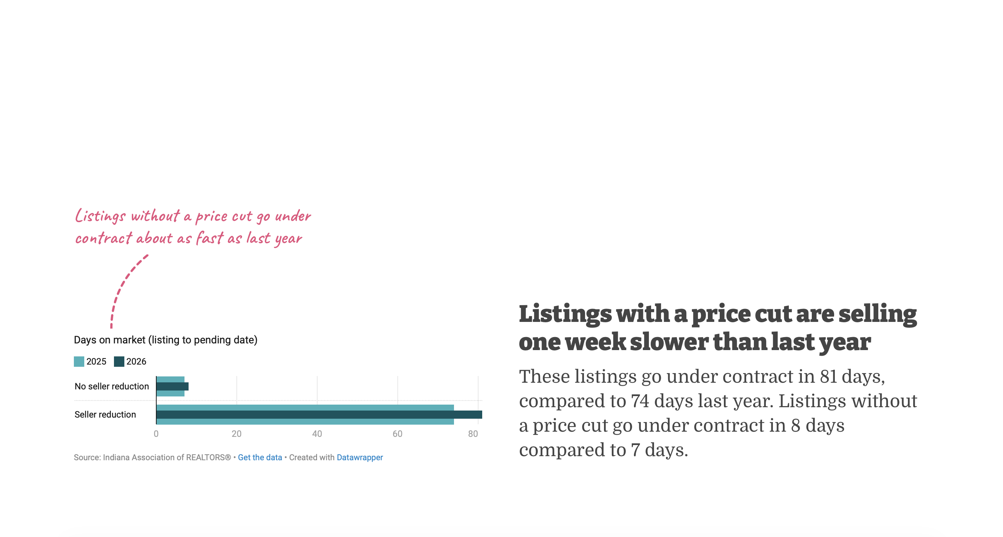
2. How Deals Changed
At the Half: Indiana Housing Mid-2026 — Indiana Association of REALTORS® 13

Slide 14
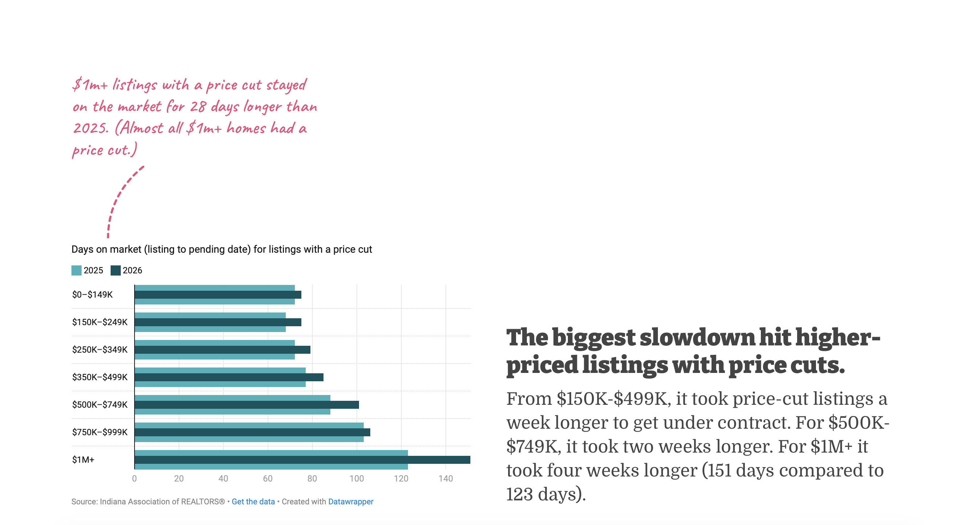
2. How Deals Changed
At the Half: Indiana Housing Mid-2026 — Indiana Association of REALTORS® 14

Slide 15
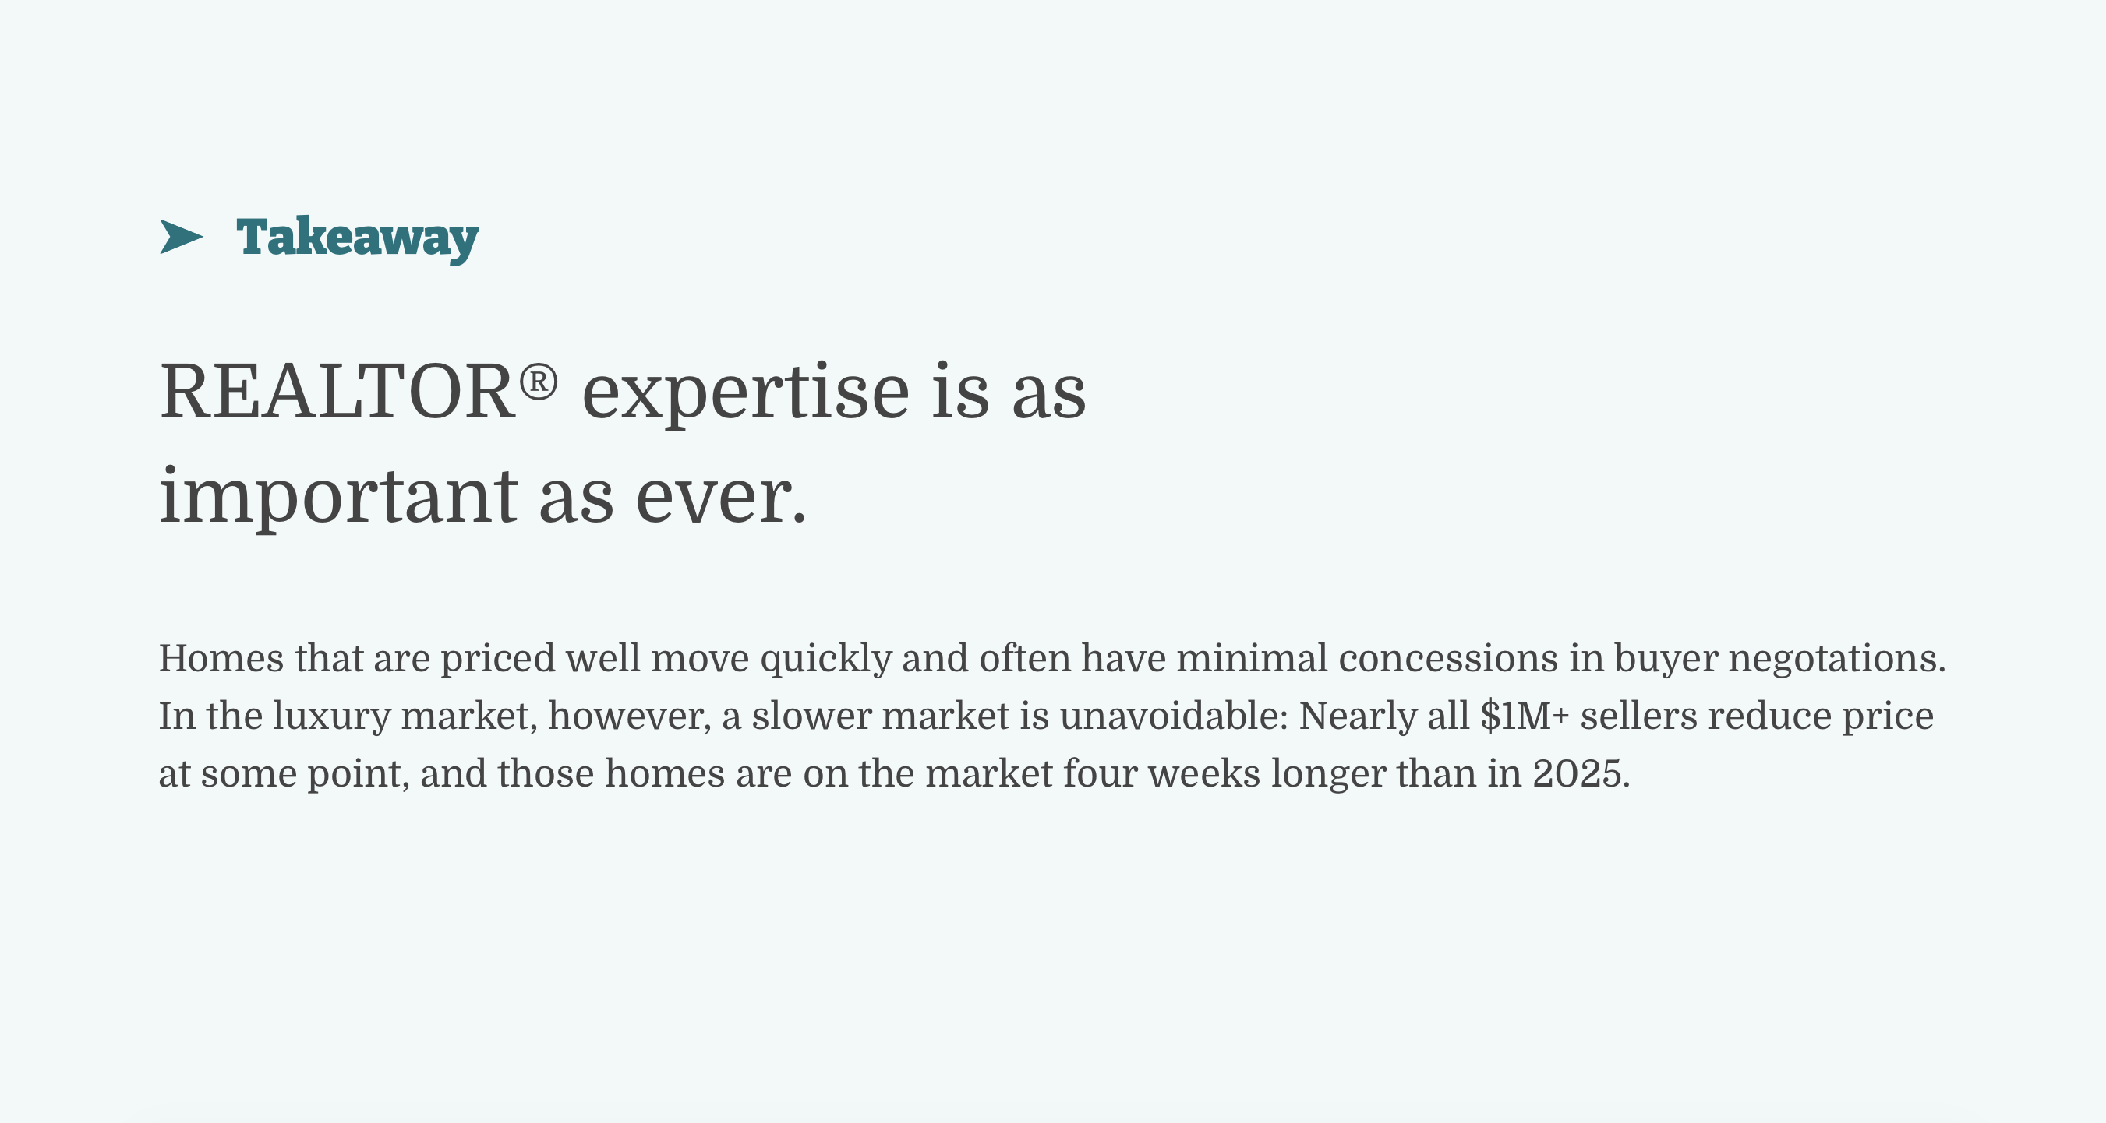
2. How Deals Changed
At the Half: Indiana Housing Mid-2026 — Indiana Association of REALTORS® 15

Slide 16
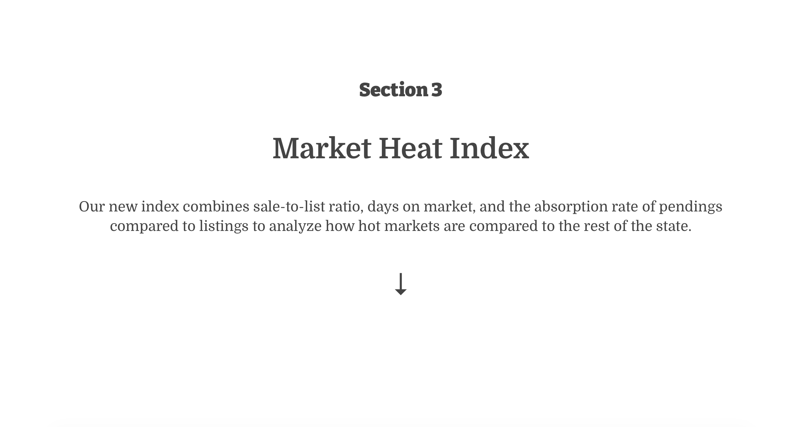
At the Half: Indiana Housing Mid-2026 — Indiana Association of REALTORS® 16

Slide 17
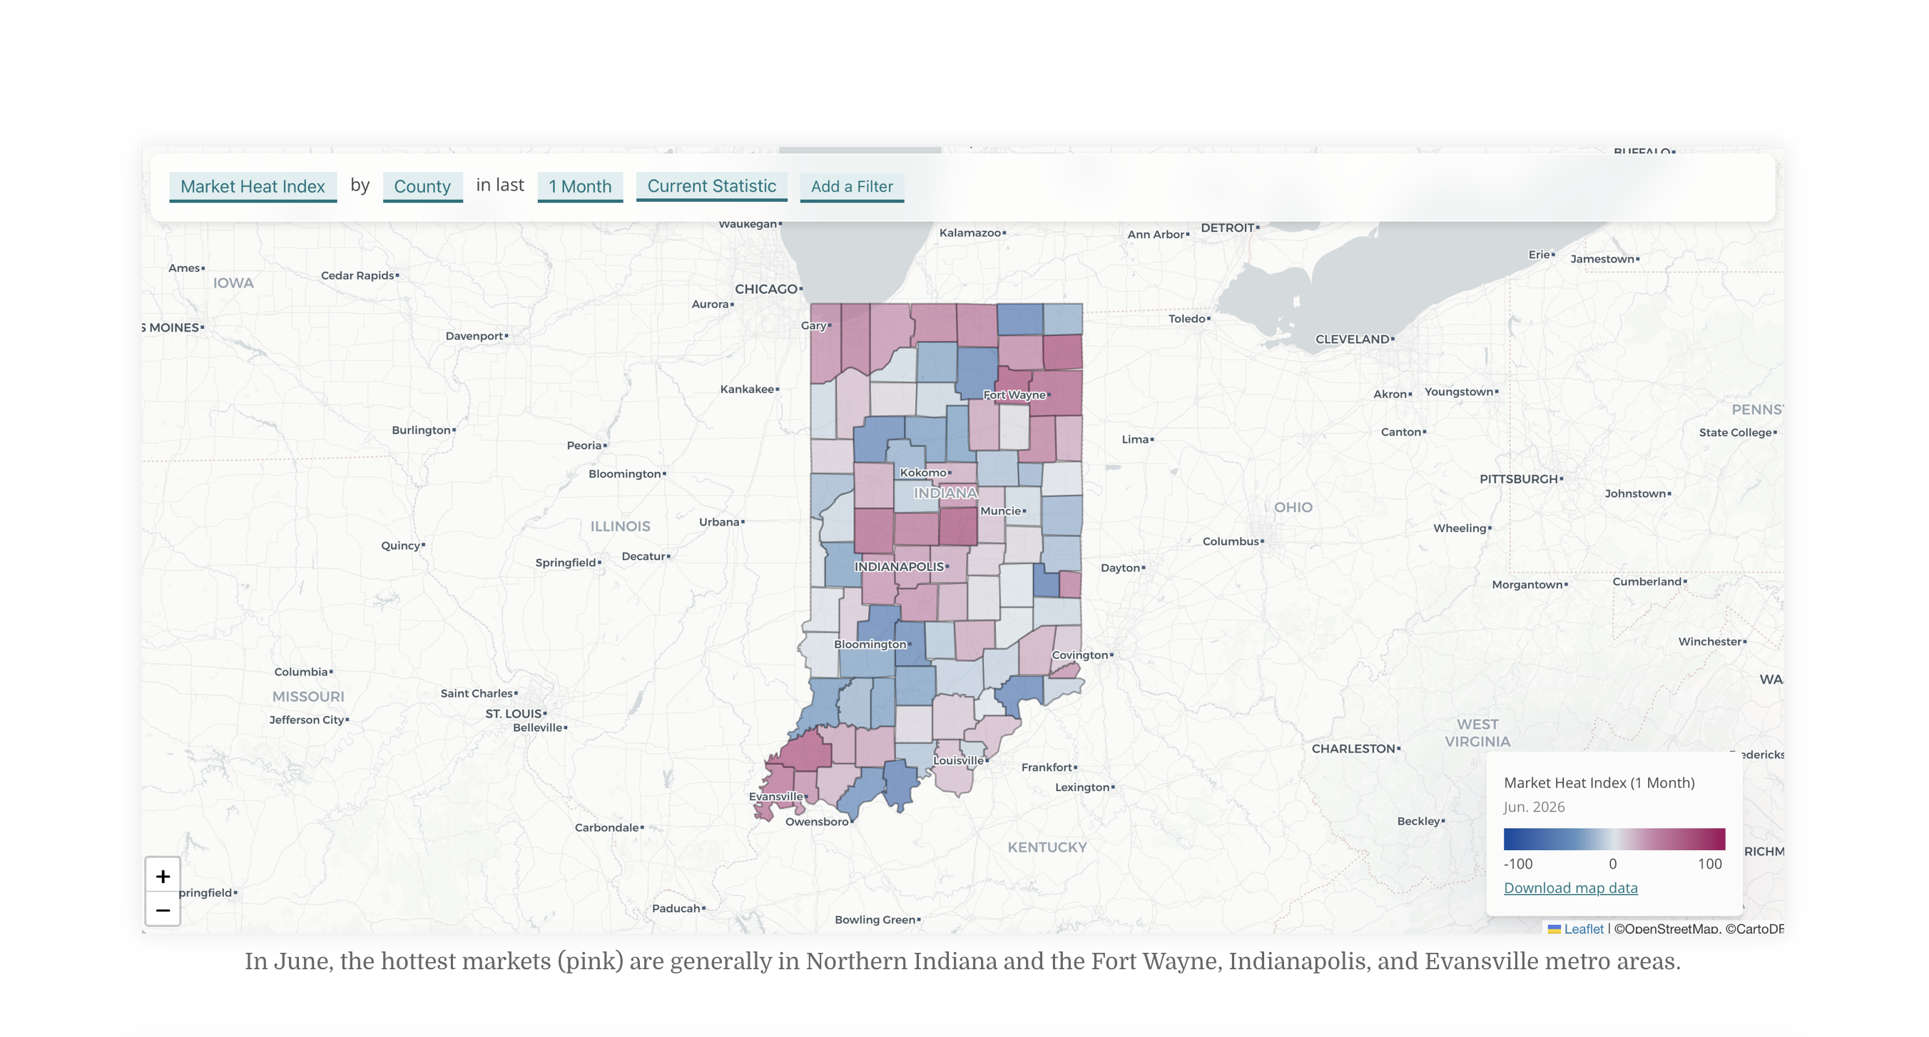
3. Market Heat Index
At the Half: Indiana Housing Mid-2026 — Indiana Association of REALTORS® 17

Slide 18
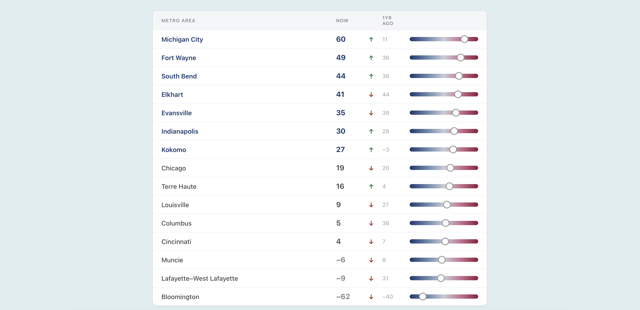
3. Market Heat Index
At the Half: Indiana Housing Mid-2026 — Indiana Association of REALTORS® 18

Slide 19
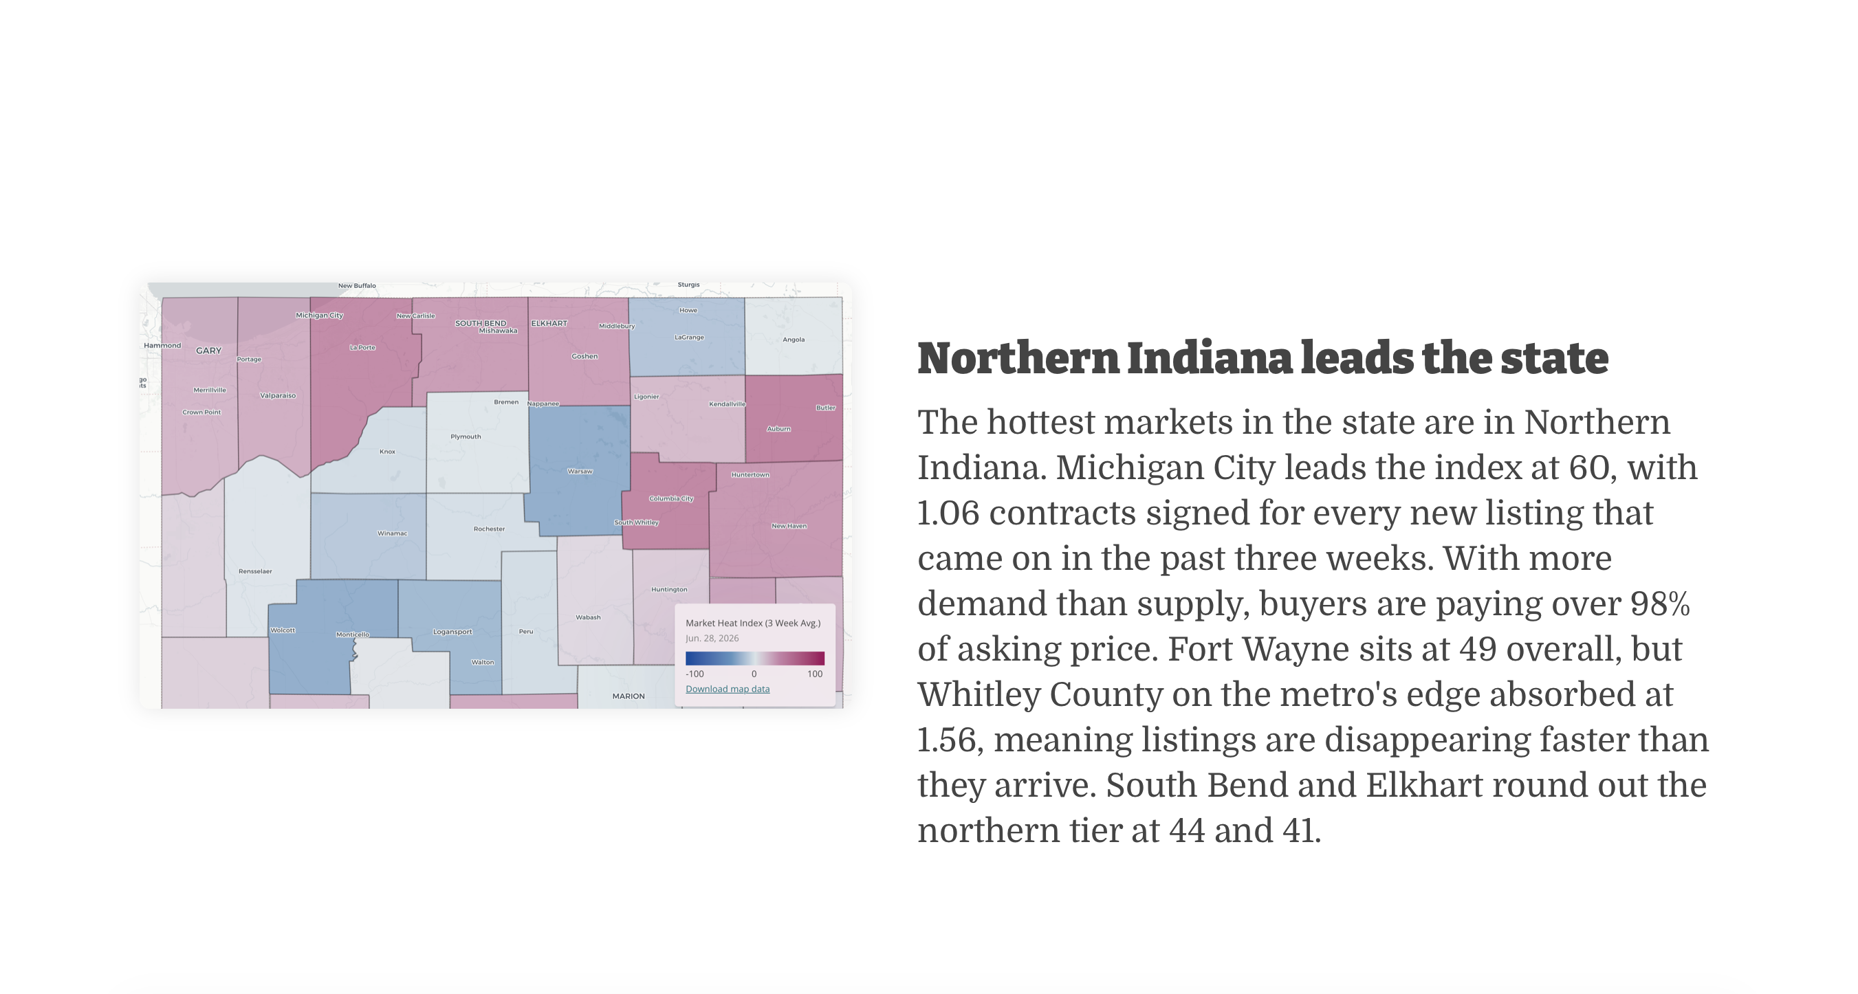
3. Market Heat Index
At the Half: Indiana Housing Mid-2026 — Indiana Association of REALTORS® 19

Slide 20
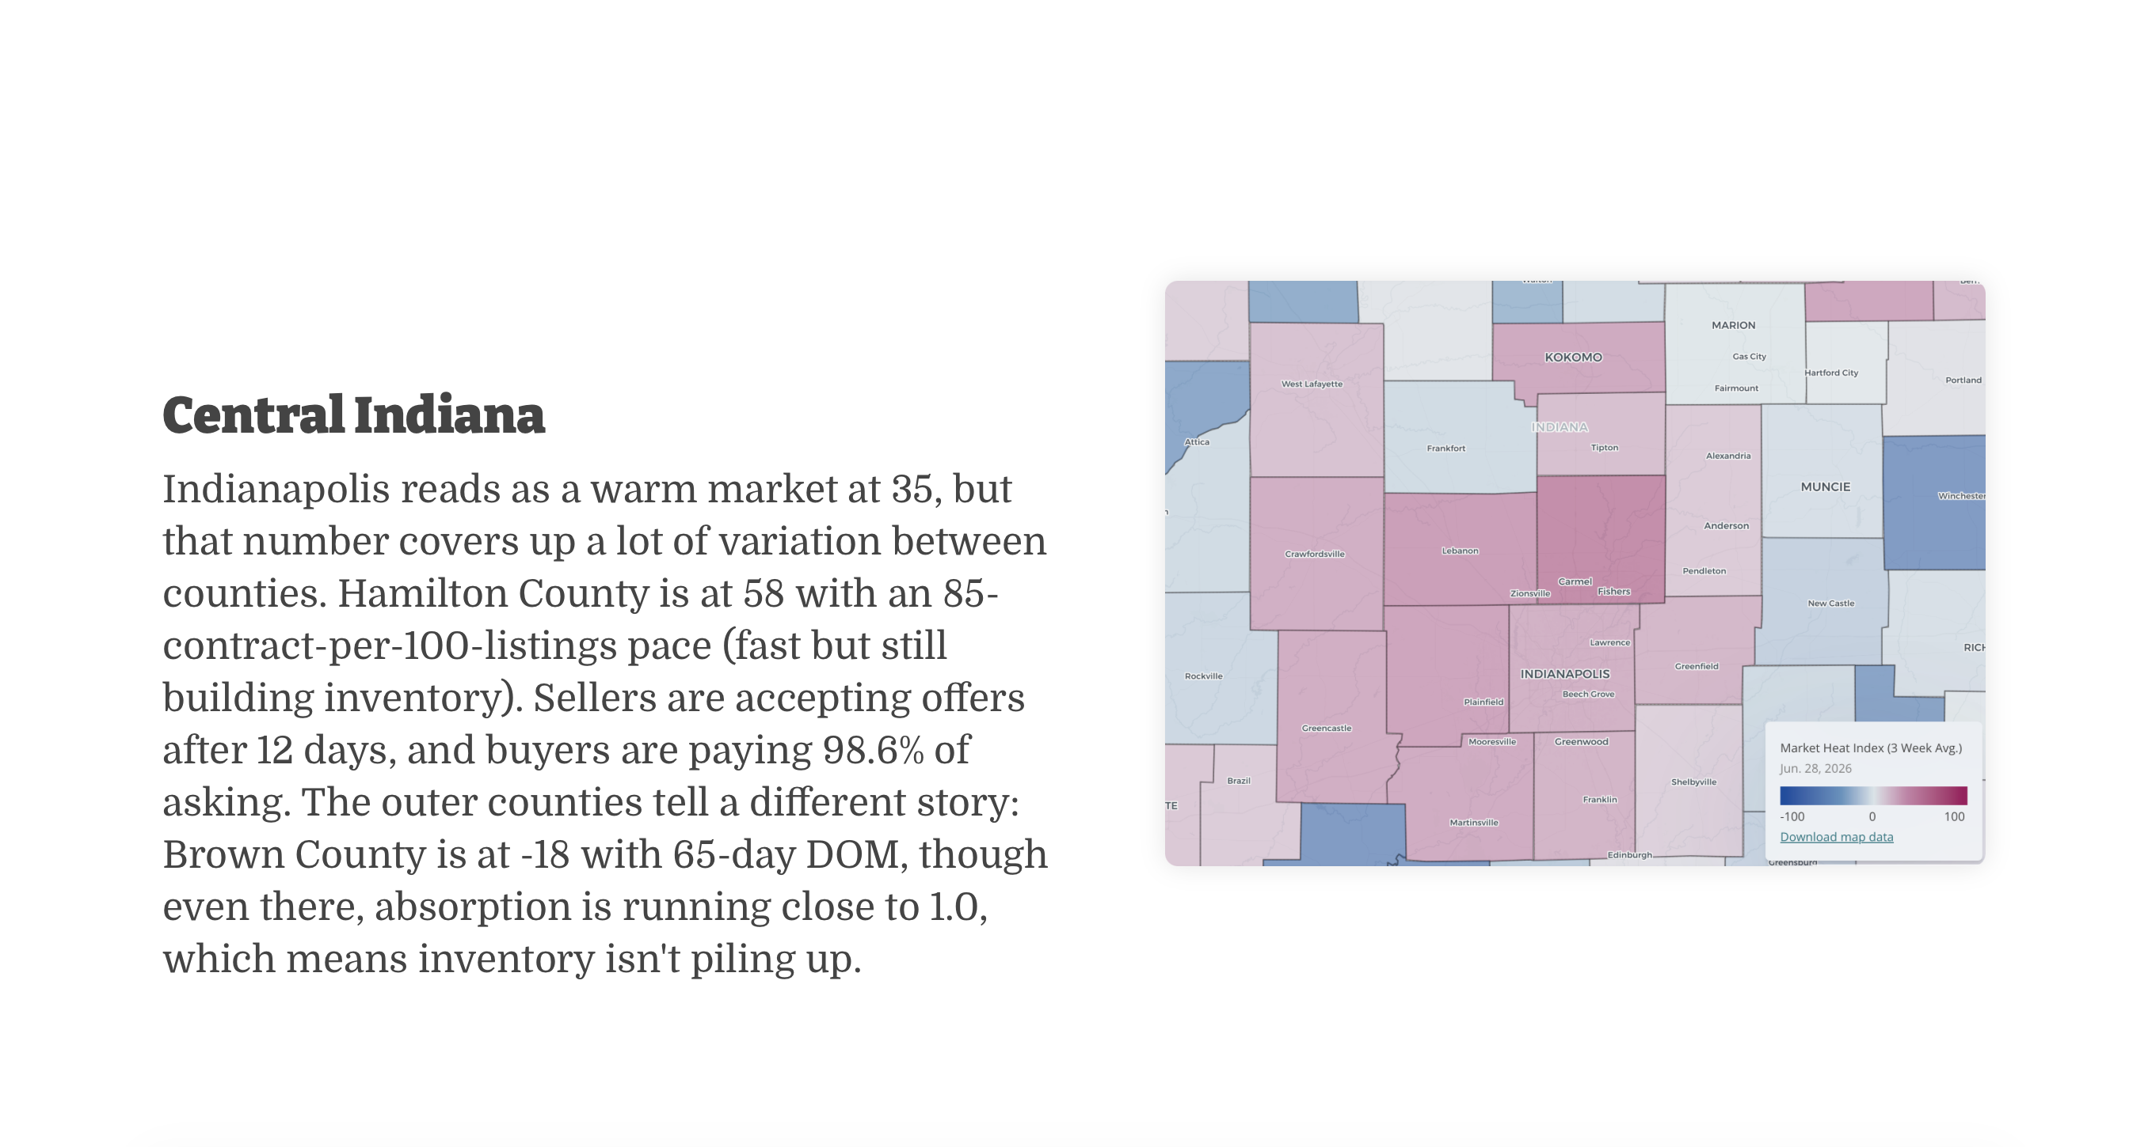
3. Market Heat Index
At the Half: Indiana Housing Mid-2026 — Indiana Association of REALTORS® 20

Slide 21
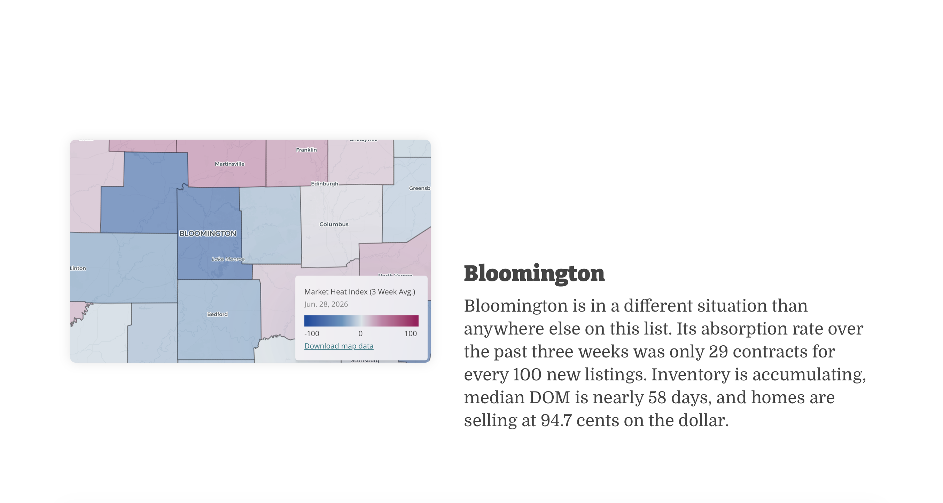
3. Market Heat Index
At the Half: Indiana Housing Mid-2026 — Indiana Association of REALTORS® 21

